Slide 1
Mobile Operating System
Overview-LAB1

Slide 2
What is Operating System for?
In order to communicate with hardware we need application and system software
Common Operating System
Network OS - Unix, Linux
Desktop OS - macOS, DOS, Window
Mobile OS - iPhone IOS, Android, PalmOS
*some application work only certain ones
*Android and IOS are so good on their game

Slide 3
Mobile OS
A mobile operating system is software that allows smartphones, (personal computers) and other devices to run applications and programs.
Let’s look at them:
IOS
Android
Symbian
Blackberry OS
Window mobile

Slide 4

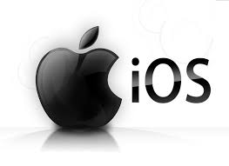
But…
Android and IOS are dominant on the marketplace, so in order to create new OS companies(big companies) are need huge amount of money.

Slide 5
Apple IOS
Based on Unix
Closed source
Exclusive to Apple products- Apple iPhone and Apple iPad
Apps are available to users on AppStore
Apps must be approved by Apple before release

Slide 6
Open source, based on Linux Apps are available on Google Play, also from 3rd parties Supported on many devices Apps are developed with Android SDK
Android OS

Slide 7
Windows Mobile Closed source Windows OS Based on NT kernel Apps available from Windows Store

